Slide 1
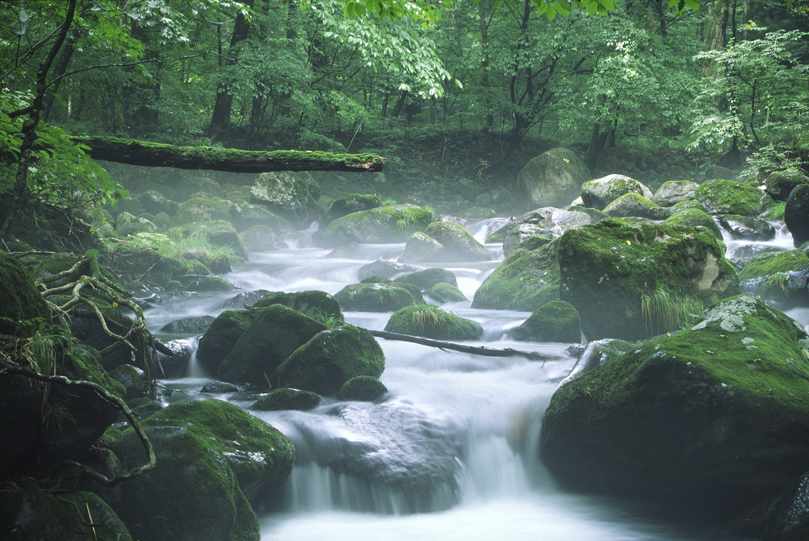
Why are Small Streams Important
&
How Are They Being Managed in BC?
Derek Tripp
Dr. John Rex
Dr. Peter Tschaplinski

Slide 2
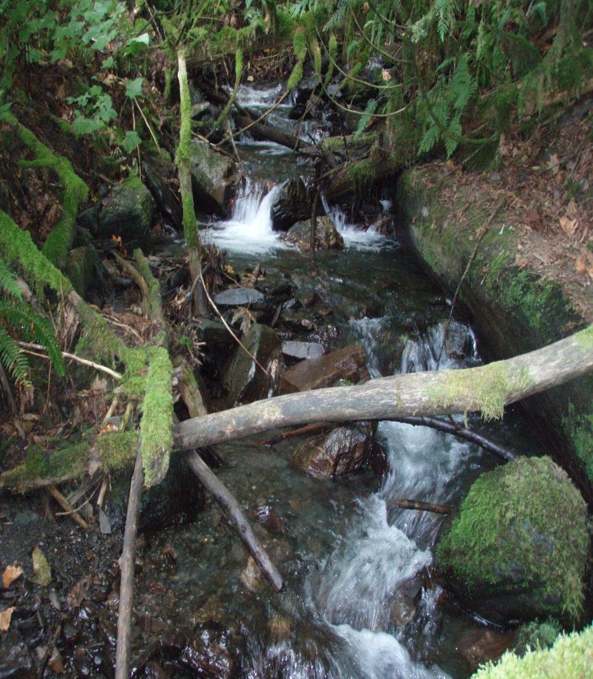
Q. What are small streams?
Features with more or less continuous definable banks formed by flowing water
Have evidence of mineral material being “sorted” or “moved” by water
Forest Practise Code S4 and S6 streams (i.e. streams less than 3m wide and no fish, or less than 1.5m wide with fish)
Approximately equivalent to 1st and 2nd order streams on maps

Slide 3
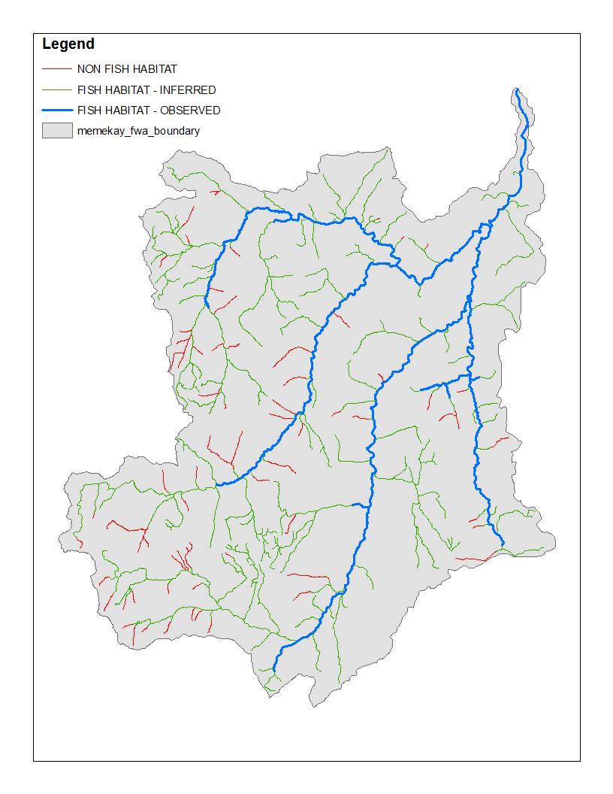
Q. Where are Small Streams?
A. Everywhere
1st and 2nd order streams are first stream segments in watershed networks
1st order are smallest unbranched segments
2nd order streams are formed when two 1st orders come together
3rd order streams are formed when two 2nd order streams come together
And so on
Largest stream in world is 12th order (the Amazon River)

Slide 4
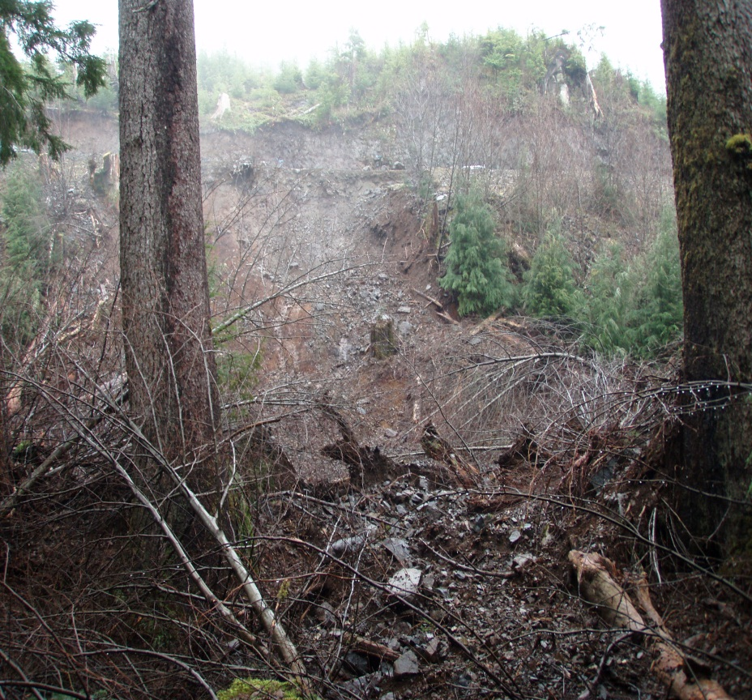
Q. What are Small Stream Like?
A. Highly Variable
10X difference in width (0.3 -3.0 m)
100X difference in flows (10L/s – 1,000L/s)
365X difference in flow duration (ephemeral, intermittent, perennial)
Substrates fine grained soils to bedrock and everything between
Show steepest (headwaters) and lowest gradients (plateaus and floodplains) in most watersheds
Connectivity to side slopes also often both highest and lowest

Slide 5
Q. How much do small streams contribute to stream number, length, and drainage area
A. Lots!
1st and 2nd order streams typically represent >80% of the stream number, length or drainage area
Most water in watersheds therefore originates in small streams
Large stream catchment area is small relative to small streams
Main role of large streams is conveying water downstream

Slide 6
Duhl River Watershed (99 km²)

Slide 7
Contribution to Wetted Area
Wetted area by stream order obtained by multiplying total stream length by average bankfull width
Average bank full width derived from basic relationships between average drainage area and expected bankfull width
Total wetted area for example is 100 ha (1% of total watershed area)
1st and 2nd streams are 50% of total wetted area

Slide 8
Summary of Number, Length, Drainage Area and Wetted Area Data
1st and 2nd Order Streams Represented:
95% of the streams
89% of total stream length
87% of total drainage area
50% of total wetted area

Slide 9
Relative Value of Different Size Streams by Ecosystem Component
Ecosystem Component | Driving Factor 1 | Driving Factor 2 | Driving Factor 3 | Relative importance of small streams | Relative importance of large streams
Water | drainage area |  |  | 85 | 15
Leaves | stream length |  |  | 90 | 10
FPOM | wetted area | Leaves, wood | % shredders | 70 | 30
Algae | wetted area | light | nutrients | 52 | 48
Benthic Invertebrates | wetted area | periphyton | FPOM | 25 | 75
Amphibians | wetted area with no fish |  |  | 80 | 20
Fish | wetted area | wetted area accessible |  | 20 | 80

Slide 10
Relative Value of Different Size Streams by Ecosystem Component
Small streams (1st & 2nd)
Large streams (>2nd order)

Slide 11
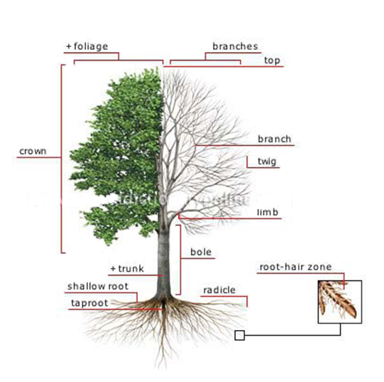
Watershed Networks vs Tree Structure
Watershed networks resemble the branching networks in the crown of a tree, or the branching roots of its root system
Small streams are the needles, leaves, twigs and small branches of the crown, of the root hairs and rootlets of the root system

Slide 12
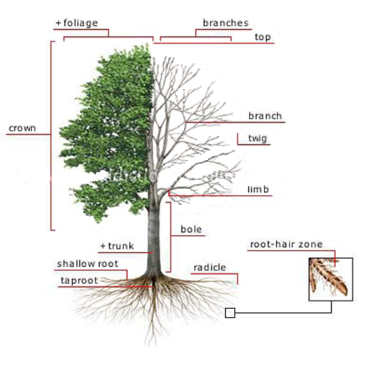
Watershed Networks vs Tree Structure
To appreciate the potential importance of small streams, imagine this tree without the foliage or small twigs and branches, as shown on the right side.
Is this the best way to imagine a watershed?

Slide 13
Watershed Networks vs Tree Structure
Watershed networks resemble the branching networks in the crown of a tree, or the branching roots of its root system
Small streams are the needles, leaves, twigs and small branches of the crown, of the root hairs and rootlets of the root system

Slide 14
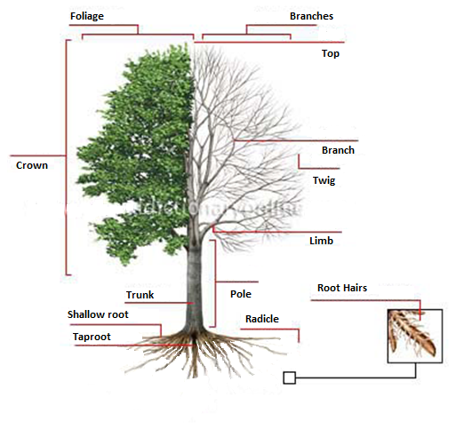
Watershed Networks vs Tree structure
Since watersheds are all about the water it may be best to just think about the root system
Consider the health of a tree without it’s “1st” or “2nd” order root hairs and rootlets, and its ability to get water or nutrients
How much of the root system can change before the tree as a whole changes?

Slide 15
Questions? Comments?

Slide 16
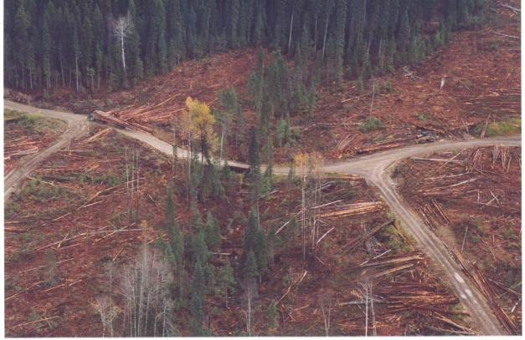


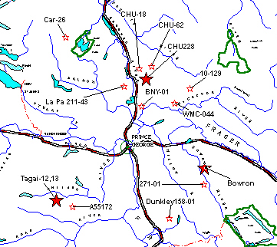
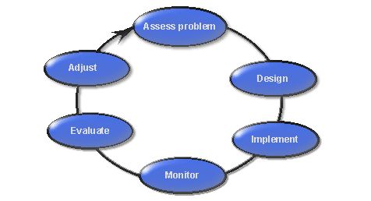






Prince George Small Streams Study
J. Rex, D. Maloney, E. MacIsaac, H. Herunter, P. Beaudry, and L. Beaudry
http://www.for.gov.bc.ca/hfp/archives/amhome/images/6steps1.gif
16
Notes:
Provide very brief history of fed/prov legislative differences around S4 streams and subsequent need for project
5 management objectives
Adaptive management approach
Applying minimum prescription of 10 stems/100m >15 cm/dbh.
2000 - 2006 (FRBC and FIA)
Three detailed study basins in the Prince George District:
Chuchinka- study and control stream
Bowron - two study and control streams
Tagai - two study and one control stream
Synoptic study areas

Slide 17
5- Year Findings
Characteristic | Variable Measured | Management Concern | MPB Salvage Considerations
Sediment supply and transport | Turbidity & Sediment sources | Low | Road Density and Crossings
Channel morphology | Width and Depth | Moderate | Increase retention for higher flows
Large woody debris and litterfall | LWD, source distance, litterfall | High | Increase retention
Air and water temperature | Temperature | High | Increase retention
Nutrients | Nitrogen & phosphorus | Low | Soil disturbance may alter levels
Biologics | Periphyton, invertebrates, & fish | Moderate | Increase retention for shade, litterfall, and temperature
Notes:
Findings:
- change in all measured parameters
- moderate management concerns are site specific – i.e. temperature increases of 3 ºC in these streams was not an issue because they were so cold, may not be the case everywhere, particularly further south.
- Management objective for long-term supply of LWD is not met, given interior recruitment processes this indicates that streams will simplify over time.

Slide 18
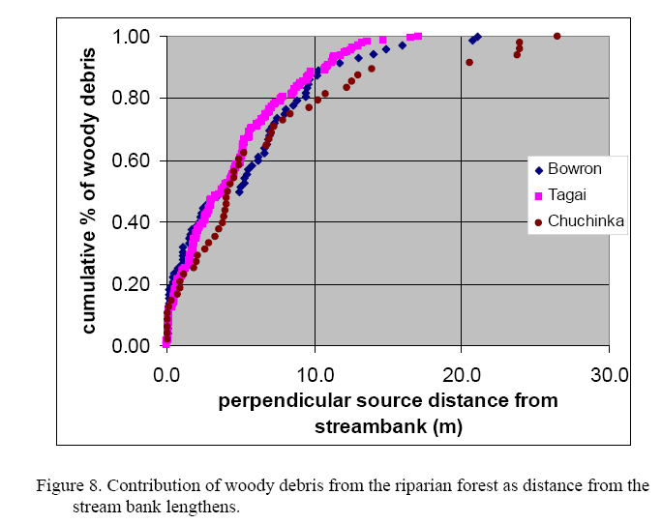
Addressing LWD Recruitment
Source distance along
bole:
  5m –> 50-68%¹
  10m –> 77-98%
  ¹Including synoptic sites.
10m may address litterfall, shade and temperature issues as well.
¹Source: Small Streams Annual Report 2006 (Pierre and Leisbet Beaudry)

Slide 19
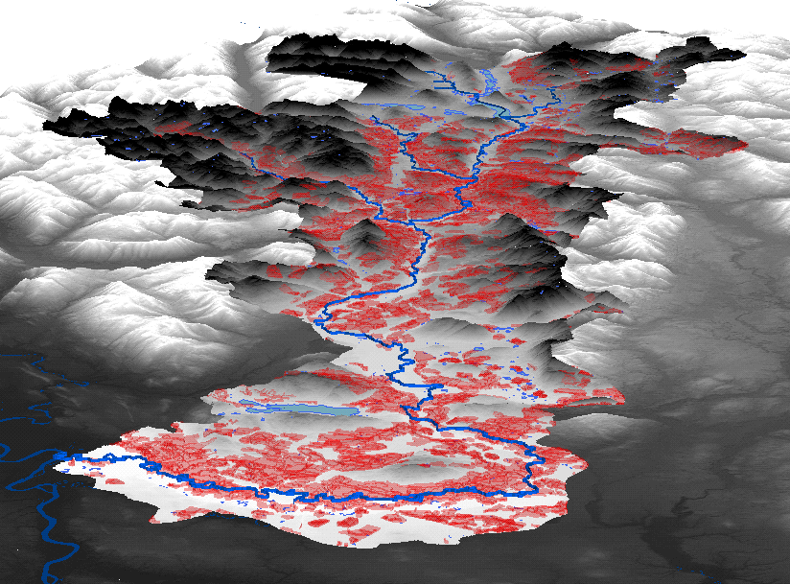
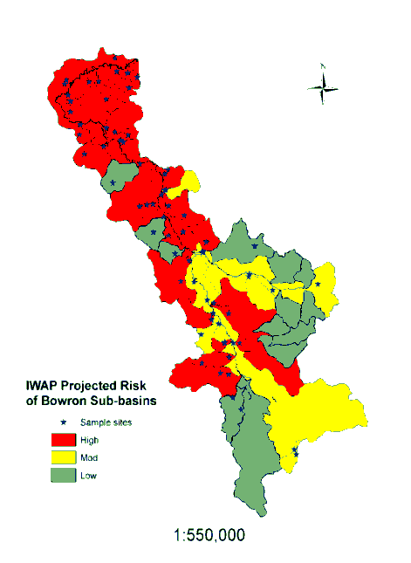



Bowron Riparian Project
L. Nordin, P. Krauskopf, D. Maloney, J. Rex, P. Tschaplinski, D. Hogan
Upper
Middle
Lower
Notes:
October 1975 a blowdown event in Bowron Lakes Park led to a spruce beetle outbreak.
Salvage logging lasted from the mid-1970’s to the mid-1980’s.
Harvesting was also intense in most of the middle and lower Bowron but occurred at a slower rate.
Watershed assessments in mid-1990s identified each of the 45 watersheds as being at high, moderate, or low risk
Assessment indicators included: riparian buffer; peak-flow; erosion; and landslide risk.
Harvesting was most extensive in the upper Bowron, 30% of which was harvested; producing a 50,000 hectare opening.
Synoptic assessment of present condition of streams and riparian zones – 71 sites
All moderate & high risk IWAP basins
Headwater and main-stem
11 low-impact reference sites (no harvesting within two RMA widths)

Slide 20
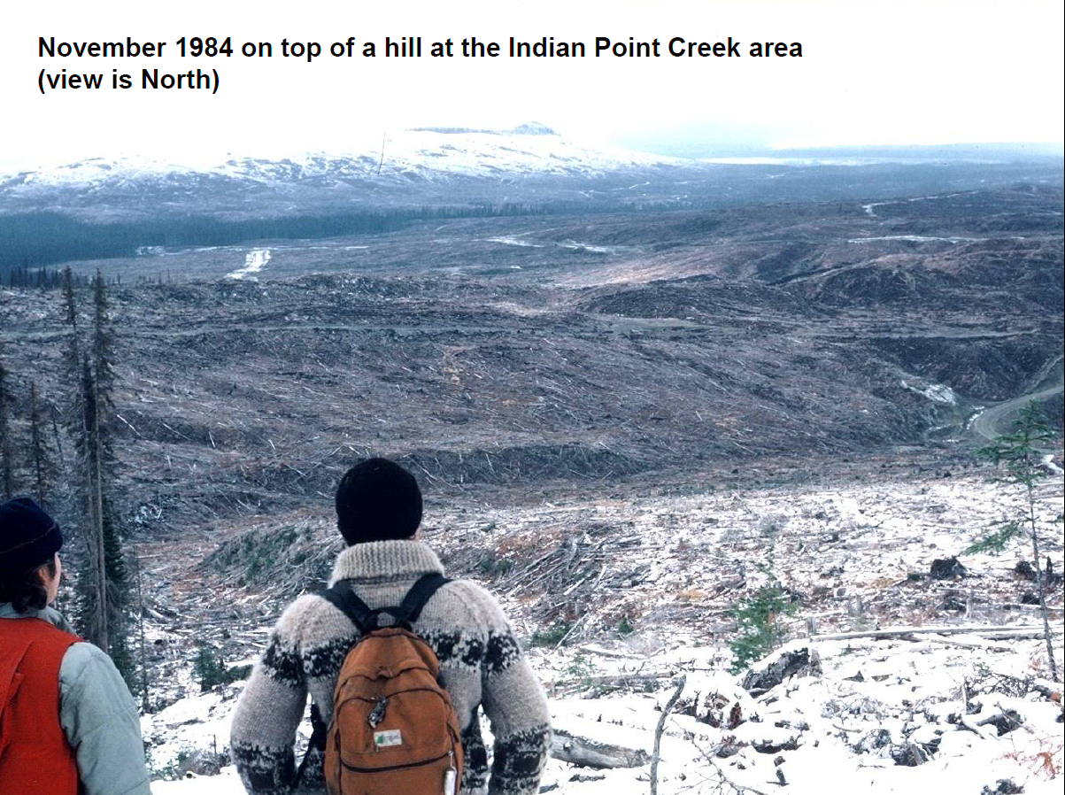
Courtesy of R. Hodgkinson

Slide 21
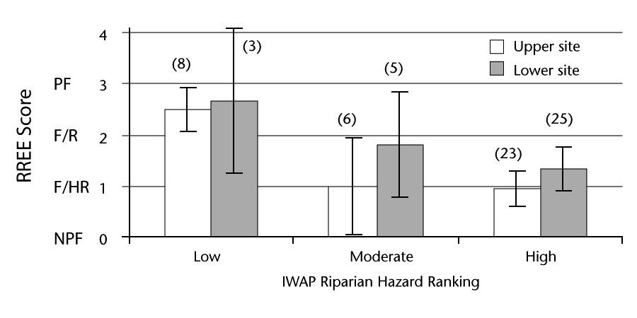
Bowron Findings
Headwater and larger streams slow to recover from extensive harvesting.
Buffers of ~3m for small streams were inadequate.
Value of IWAP as a screening tool.
Upstream riparian harvest > 30% of channel length resulted in negative downstream effects.
Figure IWAP Riparian hazard ranking vs average 2007 evaluation score. NPF = not properly functioning, F/HR = functioning at
high risk, F/R = functioning at risk, PF = properly functioning. Error bars = 95% CI.

Slide 22
FREP Observations
Small streams even slower to recover from extensive harvesting.
Logging related impacts often still present at time of second cut 60-80 years later
Impacts include old debris blockages, failed crossings, channel infilling & loss of bank vegetation due to shading
Suspect lack of bank vegetation further contributes to bank instability, and higher than normal incidences of bank disturbance

Slide 23
Questions? Comments?

Slide 24
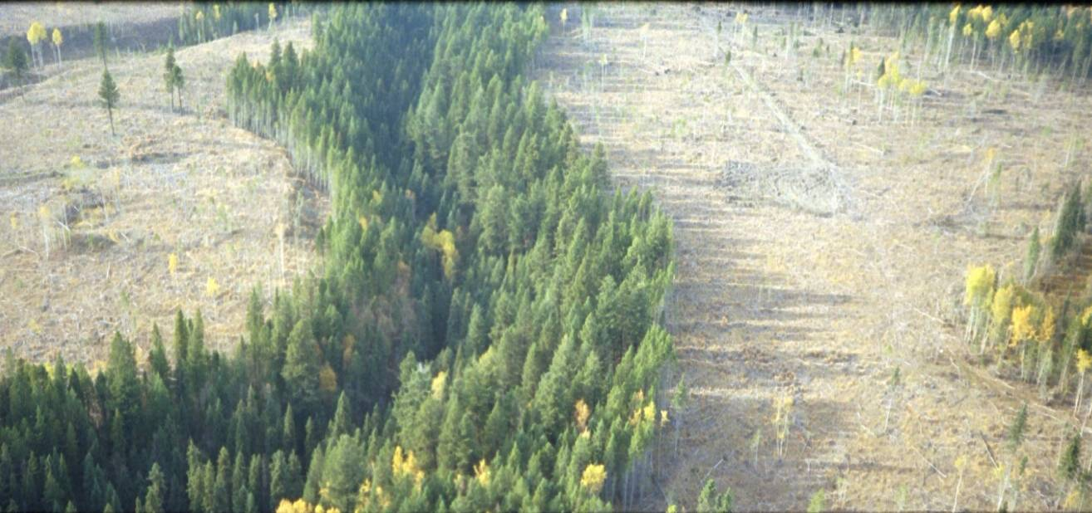
Forest & Range Evaluation Program
Practices and Post-harvest Outcomes for Class S4, S5, and S6 Streams

Slide 25
Province-wide Riparian Retention Levels by Stream Class
Stream Location Relative to Cutblock | Stream Class |  | Mean Equivalent Buffer (m) within 10 m of Stream | Total Retention in RMZ (m Equiv. Buffer) | Presence of 10-m wide buffer (% of streams)
 |  | n |  |  | NO | YES
Adjacent | S4 | 189 | 8.4 | 20.0 | 34 | 66
 | S5 | 102 | 8.7 | 23.2 | 26 | 74
 | S6 | 301 | 7.5 | 13.6 | 40 | 60
In-block | S4 | 117 | 5.2 | 12.5 | 60 | 40
 | S5 | 50 | 6.1 | 15.8 | 54 | 46
 | S6 | 635 | 2.4 | 4.2 | 86 | 14
All Locations | S4 | 306 | 7.2 | 17.1 | 44 | 56
 | S5 | 152 | 7.8 | 20.8 | 35 | 65
 | S6 | 936 | 4.0 | 7.2 | 71 | 29

Slide 26
Post-harvest Condition vs. Mean Equivalent Buffer Width
Stream Location Relative to Cutblock | Stream Class | Properly Functioning Condition |  | PFC-L |  | PFC-I |  | Not Properly Functioning
 |  | Eq. Width (m) | n | Eq. Width (m) | n | Eq. Width (m) | n | Eq. Width (m) | n
Adjacent | S4 | 9.2 | 66 | 8.3 | 72 | 7.6 | 37 | 7.3 | 14
 | S5 | 8.8 | 69 | 9.3 | 14 | 8.4 | 12 | 6.4 | 7
 | S6 | 8.4 | 151 | 6.8 | 75 | 6.7 | 52 | 5.5 | 23
In-block | S4 | 8.2 | 28 | 5.3 | 33 | 4.0 | 33 | 3.1 | 23
 | S5 | 7.3 | 22 | 6.9 | 11 | 4.6 | 13 | 2.5 | 4
 | S6 | 5.6 | 125 | 2.5 | 189 | 1.1 | 178 | 0.9 | 143
All Locations | S4 | 8.9 | 94 | 7.3 | 105 | 5.9 | 70 | 4.7 | 37
 | S5 | 8.5 | 91 | 8.2 | 25 | 6.4 | 25 | 5.0 | 11
 | S6 | 7.1 | 276 | 3.8 | 264 | 2.4 | 230 | 1.5 | 166

Slide 27
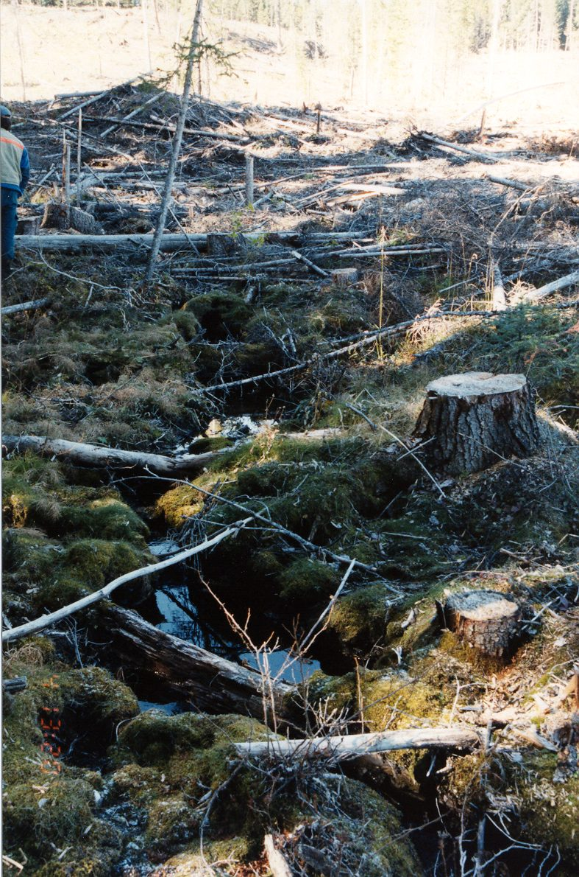
S4 Stream
Clearcut RMA:
Low impact to streambed and streambanks
Impacts to shade function, organic inputs from riparian vegetation

Slide 28
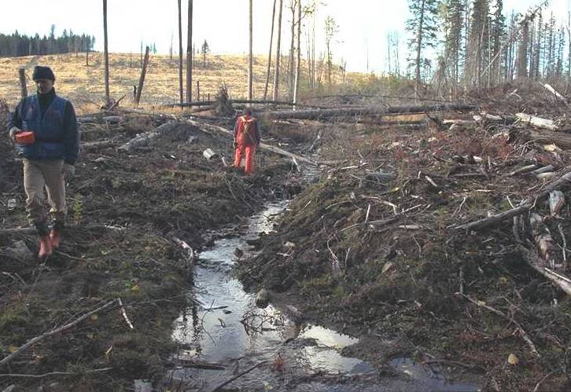
Clear-cut RMA Adjacent to Partial Retention Reach:
Streambed and streambank impacts from harvest and livestock trampling

Slide 29
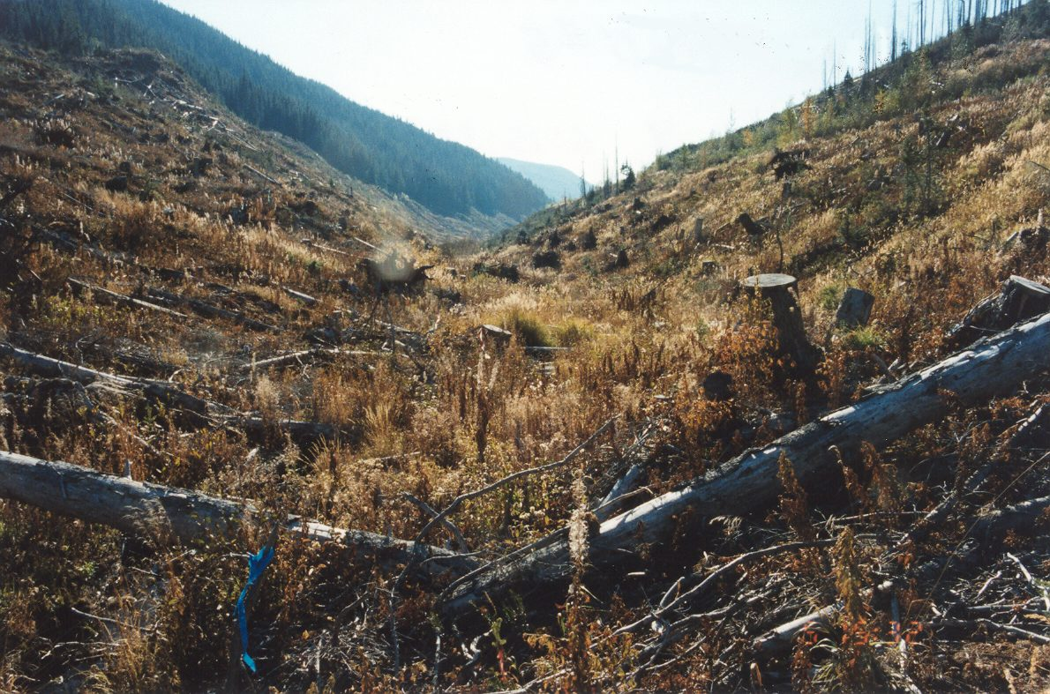
Small Stream with Clearcut RMA:
Some slash left in channel

Slide 30
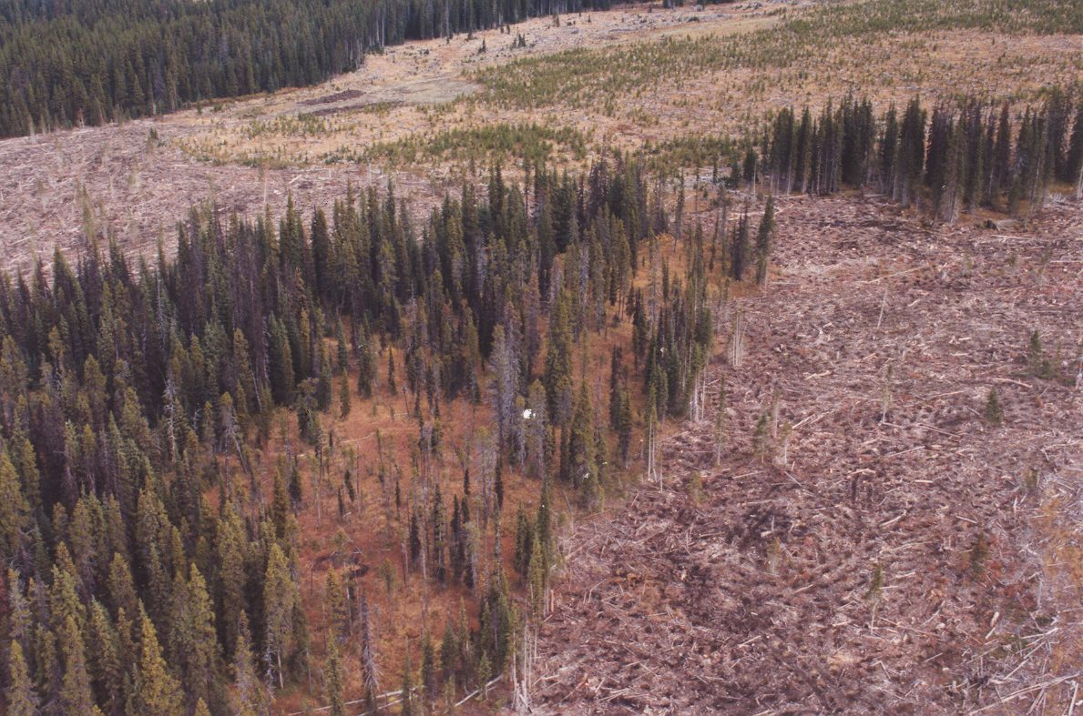
Small Stream with Wildlife Tree Patch Incorporated into the RMA

Slide 31
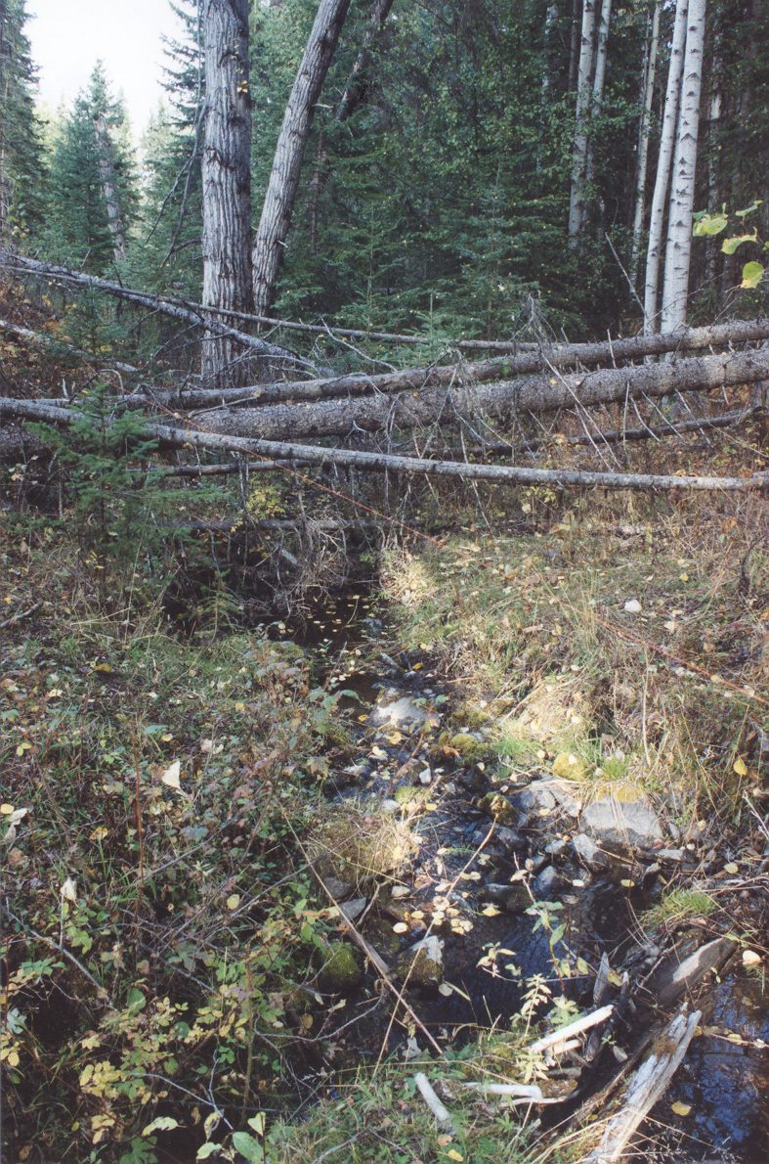
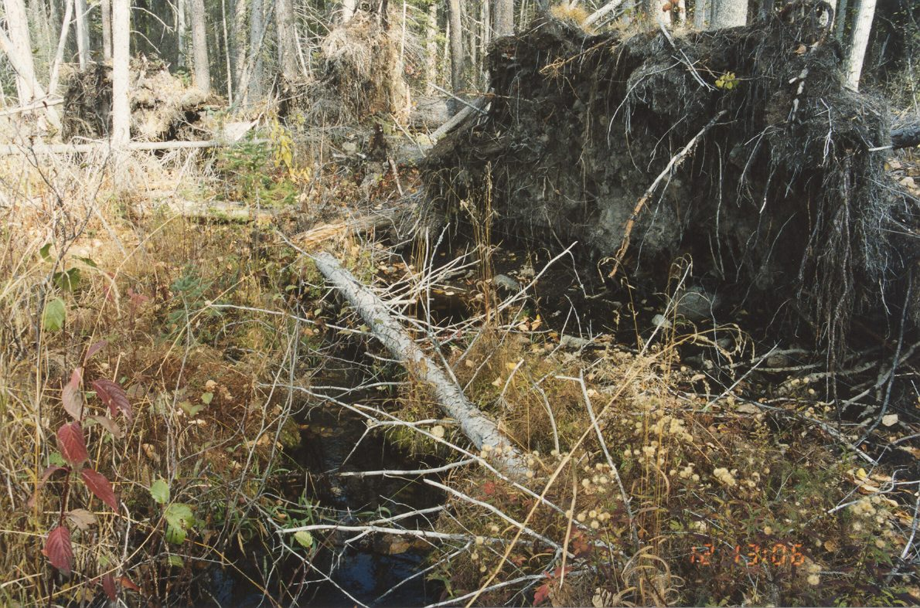
Windthrow – Potential Source of Fine Sediments
Across the stream
Streambank windtrhow

Slide 32
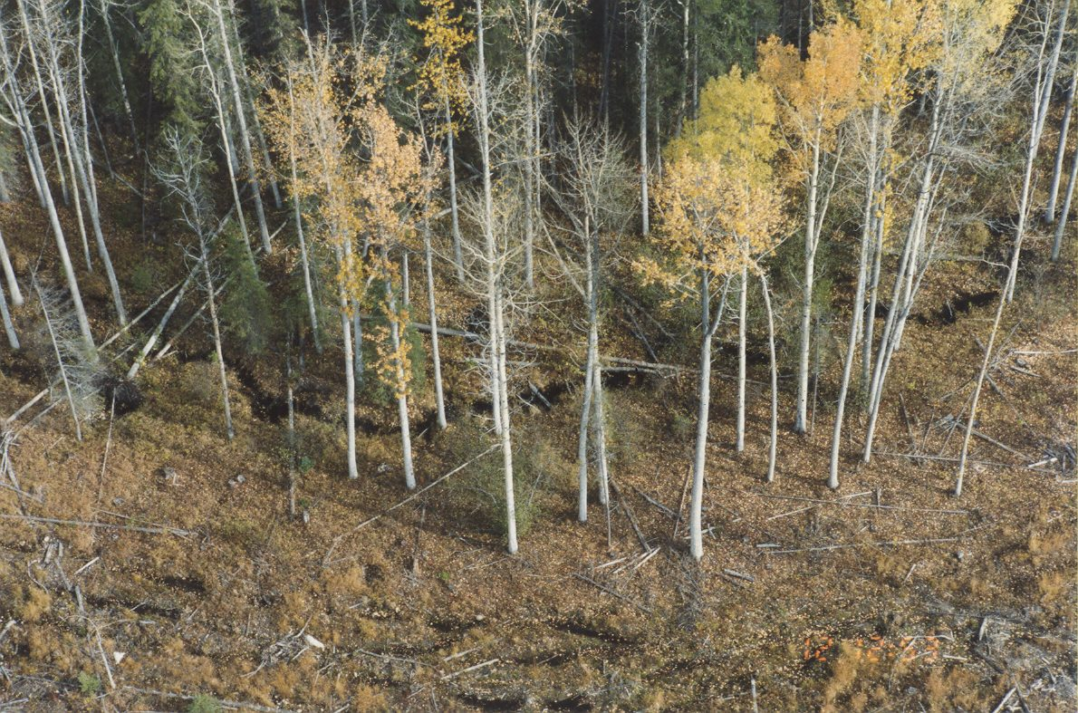
Retention of Deciduous Trees and Non-Merchantable Conifers

Slide 33
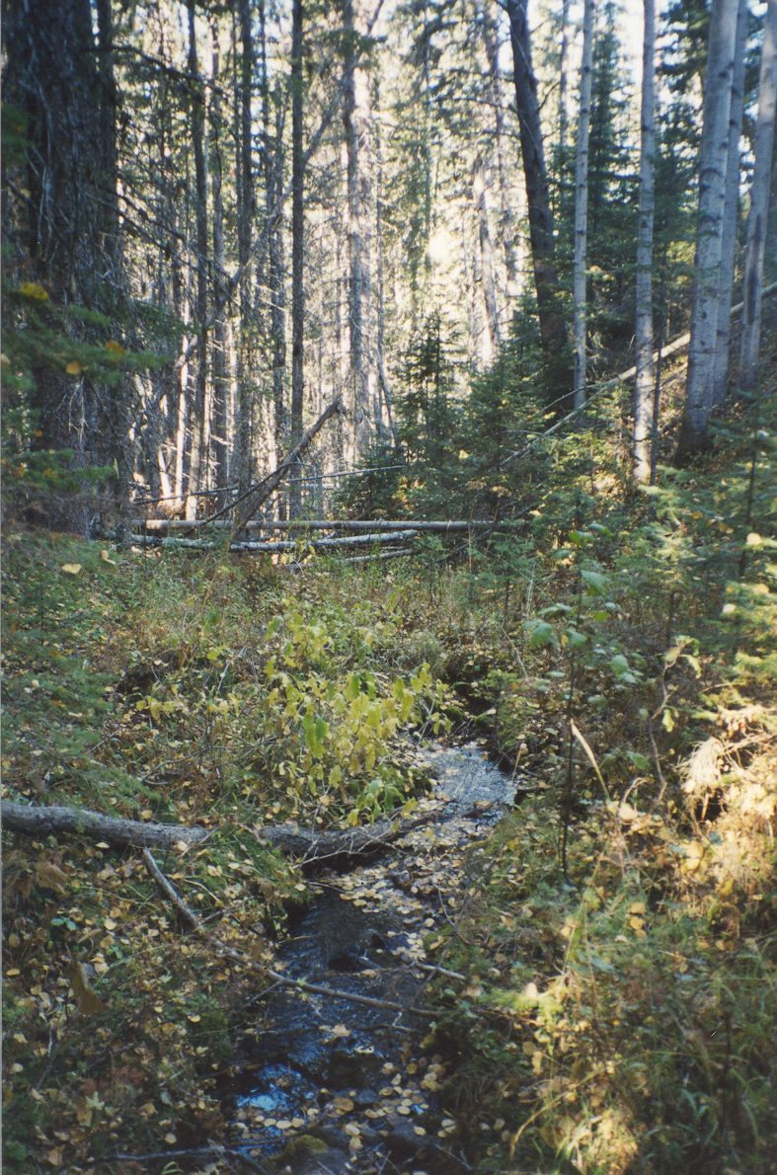
Small stream in ravine:
Full retention up to the slope break

Slide 34
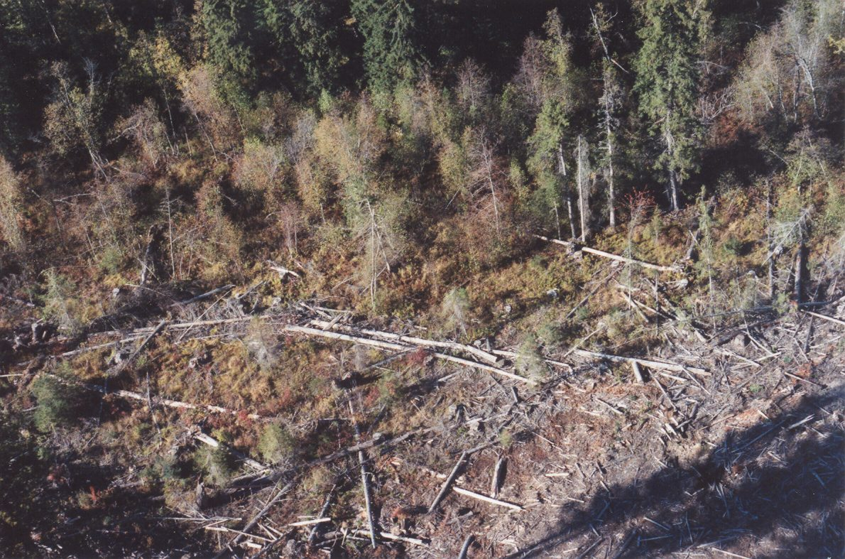
Partial RMA Retention on Cutblock Side

Slide 35
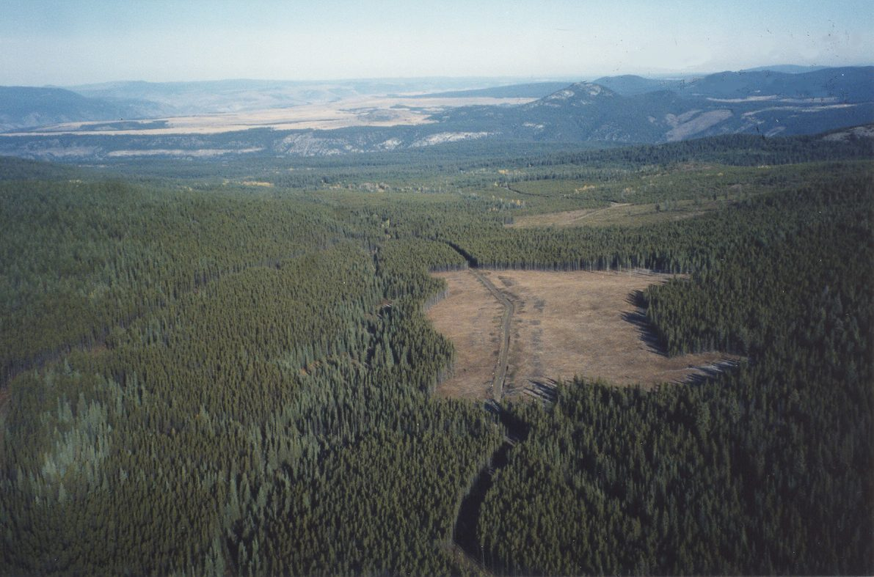
Small Stream with Cutblock Boundary on or Beyond RMA Boundary Central Interior Plateau

Slide 36
Considerations for Small Stream Management
Class S4 Fish-bearing streams
  Location within watershed
  (i) Valley bottom/floodplain
  - low gradient
  - proximity to high-value fish habitats
  - may be partially within RRZs of larger streams
  (ii) Hillslopes
  - gradient considerations
  - higher-value habitat generally in lower gradient reaches;
  e.g., < 10%
  Windthrow:
  - Retained vegetation needs to be windfirm to achieve retention
  objectives

Slide 37
Considerations for Small Stream Management
Non-fish bearing streams
  1. Size and flow characteristics
  (i) Perennial
  (ii) Intermittent (Seasonal flows; spatially interrupted)
  (iii) Ephemeral (flow only after precipitation)
  Size and flow characteristics may be linked
  2. Relationship to fish-bearing habitats
  direct connection to high-value aquatic habitats vs. other
  3. Windthrow
  Retained vegetation needs to be windfirm to achieve retention
  objectives

Slide 38
Summary and Conclusions
Small streams are ecologically important but this importance varies
  Provide water, nutrients, organic material, and inorganic sediments to aquatic environments downslope
  Are ecologically important on site – this is where the water is located on hillslopes – support local biological communities
Vary greatly in terms of size, flow characteristics, and linkages with the drainage network
  Recognize and consider these factors for riparian management strategies and practices
  One-size-fits-all approaches are not the best solutions for managing in highly variable settings

Slide 39
Questions? Comments?

Slide 40
How was the FREP Riparian Protocol Developed?
Concept and approach to assessment of PFC adapted from two related methodologies developed by academia and US BLM scientists mainly for use on east slopes of Rocky Mountains
BC methodology developed using data from almost all biogeoclimatic zones in BC
Specific indicators and monitoring protocol developed by subject matter experts and scientists from MOF, MOE, DFO, FPB and consultants
Method extensively tested and peer reviewed. Endorsed by US BLM National Riparian Team

Slide 41
What is the Baseline for the Riparian Protocol?
The baseline is a stream that is largely undisturbed by human activities
Thresholds for indicators on most questions were selected to account for most natural variability
Thresholds do not reflect average or ideal values
Study design is best referred to as the Reference Condition Approach
“Control sites” of traditional BA or BACI study designs are not required. Reference streams or reference stream conditions are the “controls”

Slide 42
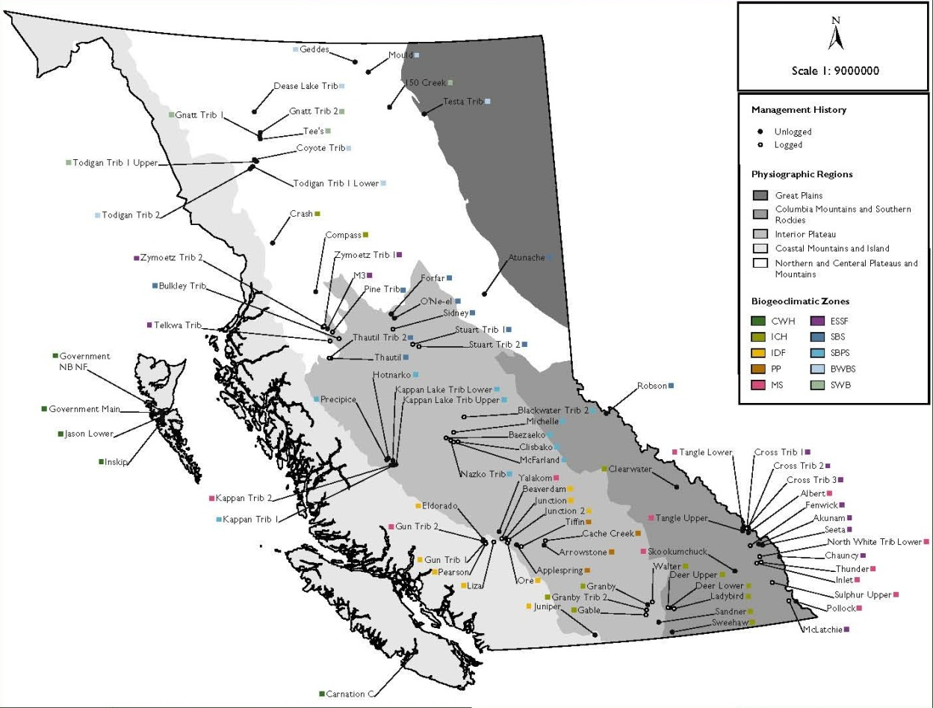
Where are the Indicator Thresholds From?
Channel and instream wood indicators (Q1-4) came from long term studies of channel characteristics in >100 logged and unlogged streams throughout BC

Slide 43
Where are the Indicator Thresholds From?
From other existing checklists (e.g. Q 11, 1%, amount of bare ground in first 10 m of the riparian area, Q15 heavy grazing <10% of forage)
From other guidebooks in BC (e.g. Q 12 retention levels for LWD supply, Q14 noxious weeds and increaser plant species abundance)
From the literature and other specific studies on logged, unlogged streams in Pacific Northwest (e.g. Q7 moss abundance, Q8 fine/sand sized sediment characteristics, Q13 shade)
From expert opinion, to address data gaps (e.g. Q5 connectivity, Q9 invertebrate diversity, Q10 windthrow, Q15 forest structure)

Slide 44
Where are the PFC Thresholds From (i.e. the number of “No” answers) ?
Other similar methods consistently consider 40% the maximum number of No answers permitted for PFC
40% cutoff based on opinions of many independent experts
Fewer “No’s” equate to less risk of streams not being in PFC
For the 15 FREP Riparian Questions, more than 6 No answers (i.e. > 40% of 15 questions) means stream is no longer in PFC

Slide 45
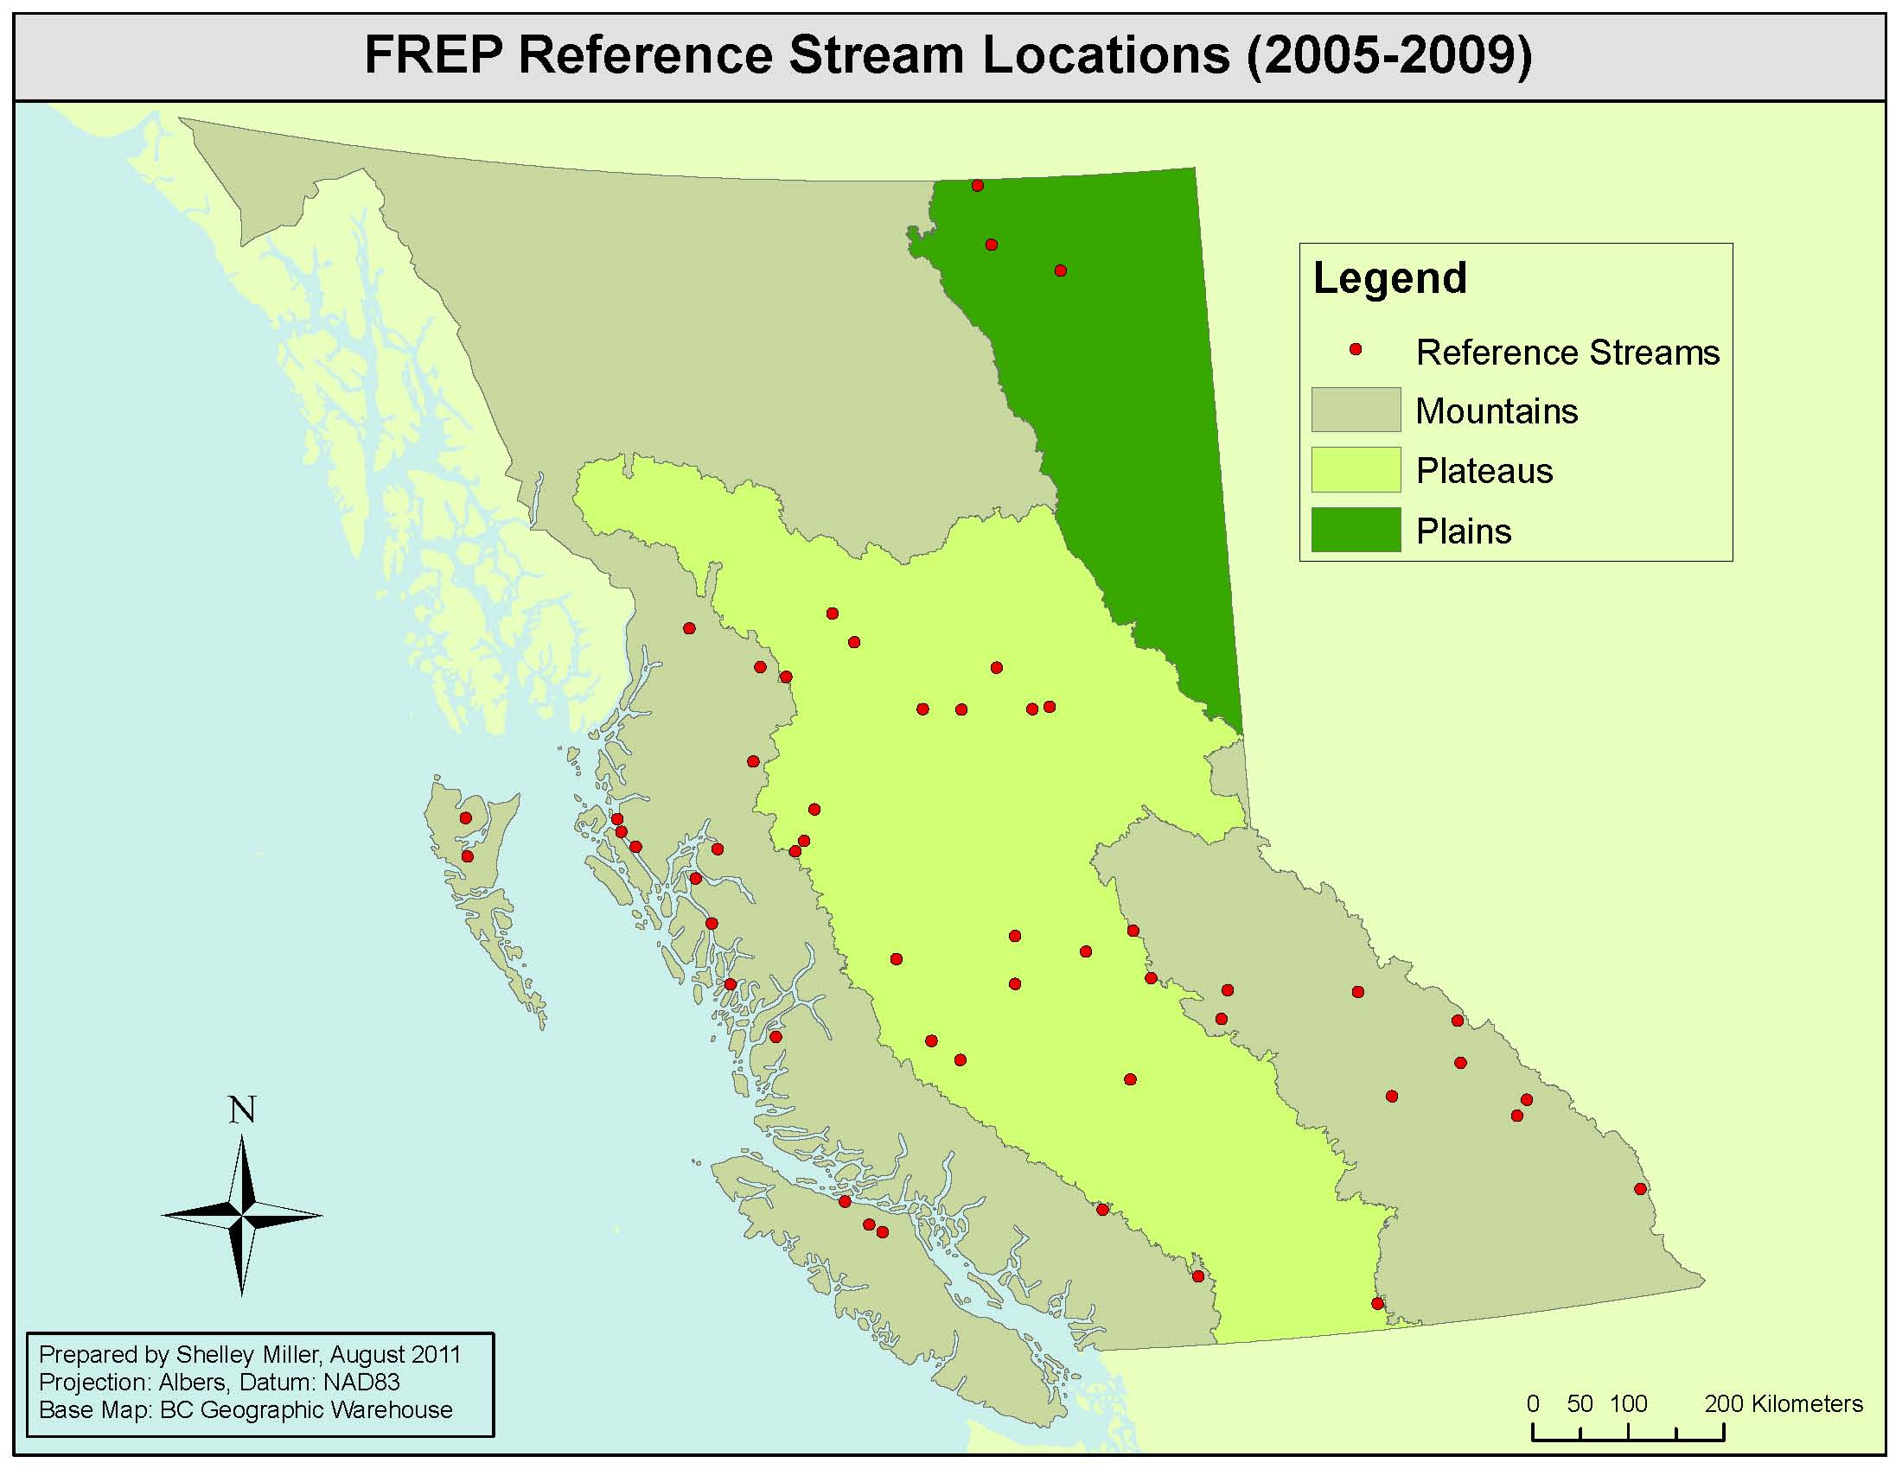
Reference Stream Conditions Support PFC Thresholds

Slide 46
Reference Stream Conditions Support PFC Thresholds

Slide 47
Reference Stream Conditions Support PFC Thresholds
No streams found to not properly functioning
39 (76%) were in PFC
10 (20%) were in PFC, at risk (limited impacts)
2 (4%) were in PFC at high risk (impacts)

Slide 48
Does a Stream Have to be Perfect to be in PFC?
NO!
Streams can be “close” to thresholds on all indicators without any “No” answers
Some Questions require at least two indicators be No before question as a whole is No. One indicator can fail without failing the main question.
Average number of “No” answers on reference streams (1.4) similar to non-cut block related “No” answers (1.1) reported by Tschaplinski (2010)

Slide 49
Questions or Comments?

